Slide 1

Promotion of agricultural products
AGRIP SIMPLE / MULTI Calls 2027
Grants
Iliyana ILIEVA, Head of Sector,
REA Agri-Food promotion grants
9 September 2026

Slide 2
Content of the presentation
Award criteria
Available guidance and information for proposal preparation – list of resources and useful tips
Examples of points to improve in the proposal (during evaluation)
Background information

Slide 3
Award criteria
RELEVANCE
IMPACT
QUALITY
THRESHOLD | SCORE
RELEVANCE | 15/25
QUALITY | 30/50
IMPACT | 15/25
TOTAL | 60/100
NB: Each Award Criterion is broken down into several Sub-Criteria, which are explained and detailed in ANNEX I of the PROGRAMME GUIDE
Evaluators assess each of the Sub-Criteria during the Evaluations

Slide 4
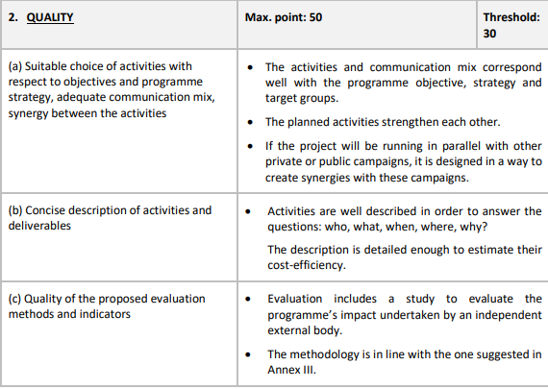
Example of Award criteria – for more information, please consult the Programme Guide
CRITERIA
MAXIMUM SCORE and THRESHOLD
CRITERIA SECTION and SUB-CRITERIA

Slide 5
Available guidance and information for proposal preparation
Funding&Tenders portal → 2026 calls SIMPLE & MULTI (2027 calls still in preparation, update expected mid-January 2027):
  Calls for proposals – Call documents (in all EU languages)
  Programme guide (in all EU languages)
  Application forms – via the submission module
  frequently asked questions (FAQ) and all EU languages e-translations directly available on F&T portal (switch language top right)
Other sources of information:
Eurobarometer: data on awareness on EU quality schemes (latest one is here)

Slide 6
Available guidance – click on the links
F&T portal AGRIP section
DG AGRI Webpage
Enjoy it’s from Europe Portal
REA Webpage
General information; FAQs
How to apply?
Campaigns’ map
Policy information

Slide 7
Proposal preparation – list of resources
REA webpage:
Legal framework (Regulation (EU) No 1144/2014; Commission Delegated Regulation (EU) 1829/2015 and its amending act 2025/70; Commission Implementing Regulation (EU) 1831/2015)
  Relevant Information to prepare proposals (How to Apply)
  Eligibility factsheets (applicants, products and activities)
  Information for exporters: market entry handbooks (27 market research reports (countries outside the EU), Access2Market portal and other reports and information relevant to markets of third countries

Slide 8

Proposal preparation – list of resources
REA webpage (continuation):
  Information relative to IPR (intellectual property rights): protection of geographical indications, brands on third markets (webinars, factsheets, links to IPR helpdesks)
  EIFE campaigns map (information on all co-financed programmes)
  Events and campaigns organised by the EC
  Subscribe to the newsletter to receive the latest news!

Slide 9
Proposal preparation – useful tips
Read carefully the Call documents, FAQs, and relevant EU Regulations: Is my organisation eligible? Which Call topic is most suitable for my proposal? Is it compliant with all call conditions?
Follow the instructions provided in the Programme guide (available in all EU languages)
If you want to open new markets, consult Access2Market portal
Ensure budget is commensurate for the activities proposed
Pay attention to the Award criteria and subcriteria
Ensure EN translations of excellent quality
Keep in mind that every point counts for the overall score! Give your best at each part of the proposal. Ensure consistency and coherence.
Avoid redundancies. Don’t copy parts of a Regulation to the proposal
Do not wait until the last minute to submit your proposal
Questions? Contact rea-agri-grants@ec.Europa.eu

Slide 10
Proposal preparation – project management approach
QUALITY (max. 50)
IMPACT (max. score 25)
Market Analysis
-CREATE A RED THREAD THROUGH THE DIFFERENT
SECTIONS OF THE PROPOSAL
-MIND THE CALL TOPIC YOU SELECTED
SWOT
Project Objectives/SMART, Strategy & Target group definition
RELEVANCE (max score 25)
Quality of communication mix& activities, suitable budget
Project managementcoordination and evaluation
Risk & Financial Mgmt.
Return of invest-
ment: Awareness
Scale and coverage
Return of investment: Economic return
PROPOSAL DESIGN

Slide 11
Proposal preparation – final considerations
Yearly Review in Brussels
Monitoring ≠ Evaluation
Data collection
Secure budget to cover travel costs for all project staff (beneficiaries, IB and EB representatives) for yearly review meetings in Brussels
Pay attention to the differences between Monitoring and Evaluation. Project monitoring is under applicant’s remit (you need to explain how) while evaluation is done by an EB (external company that uses their own methodology)
When preparing the proposal, focus on how you will be collecting and managing precise, high-quality data from the outset. This will help you track indicators.

Slide 12
Frequent weaknesses of proposals
Proposal does not fully address the Call topic
  Market analysis not specific enough to demonstrate alignment
  Impact on awareness not specific enough to demonstrate alignment
  Consumer behaviour not well identified on each target market in the light of the Call topic
Target groups not well defined
  Market analysis not specific enough to demonstrate knowledge of target groups on each target market
  Target groups not sufficiently described, quantified and segmented
Synergies between different activities not well explained
  How social media supports events
  How digital and face to face activities complement and reinforce each other
Key performance indicators not well specified
  Calculation of the baseline not well explained for each target market
  Output and result indicators not well defined
Calculation of impact (awareness, economic) not convincingly demonstrated

Slide 13
Useful links
Please consult the link to these two factsheets:
Eligibility of applicants - Publications Office of the EU
Eligibility of products and activities - Publications Office of the EU
Consult the basic legislation
Regulation (EU) 1144/2014 Article 7
Delegated Regulation (EU) 2015/1829 Article 1
Consult Call documents on the EU Funding&Tender portal – 2027 calls expected publication mid-January 2027
Read the SIMPLE/ MULTI Calls for proposals Chapter 6

Slide 14
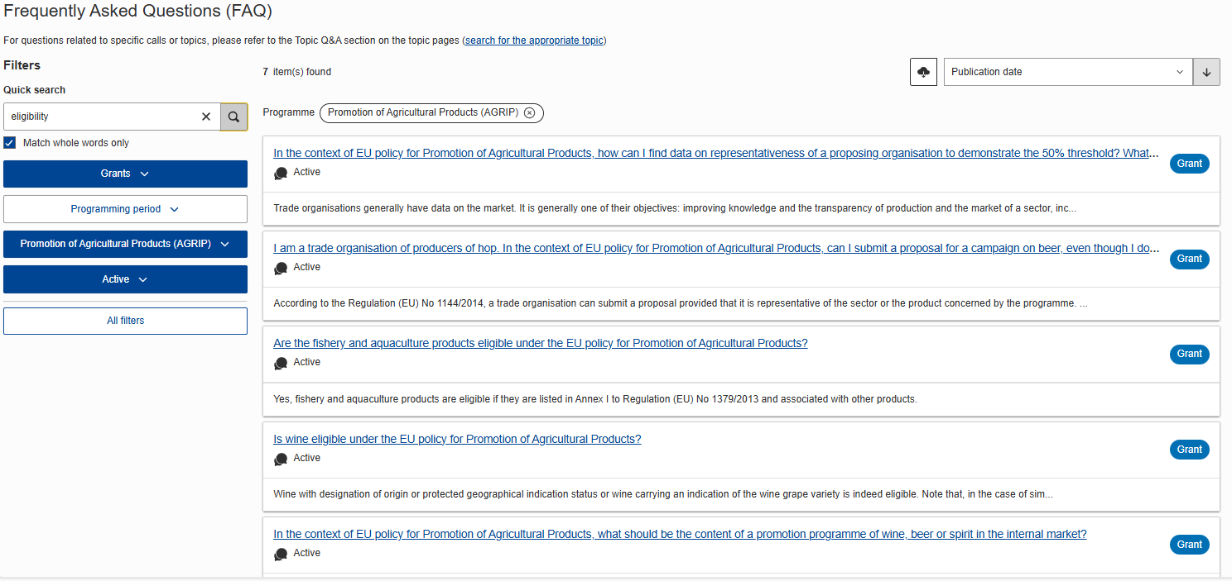
FAQ
EU Funding & Tenders Portal

Slide 15
Thank you
Fill in copyright information.
Questions (non-IT) REA-AGRI-GRANTS@ec.europa.eu
Questions (IT) IT Helpdesk contact form
© European Union 2026
Unless otherwise noted the reuse of this presentation is authorised under the CC BY 4.0 license. For any use or reproduction of elements that are not owned by the EU, permission may need to be sought directly from the respective right holders.

Slide 16

Q&A

